Slide 1
Partial Redundancy Elimination
&
Lazy Code Motion
By
Kavya B.S
Assistant Professor
Department of CSE
N.M.I.T

Slide 2
Taxonomy of Global Compiler Optimizations
Machine Independent
Redundancy
Code motion
Useless code
Create opportunities
Specialization
Redundancy Elimination
Partial Redund. Eliminat.
Consolidation
Dead Code Elimination
Partial D.C.E.
Constant Propagation
Algebraic Simplification
Replication
Strength Reduction
Constant Propagation
Method Caching
Heap→stack allocation
Tail Recursion Elimination
Today
(Lazy Code Motion)
Loop-invariant Code Motion
Consolidation
Global Scheduling
Constant Propagation
Re-association
Replication
*

Slide 3
Common-Subexpression Elimination
An occurrence of an expression in a program is a common subexpression if there is another occurrence of the expression whose evaluation always precedes this one in execution order and if the operands of the expression remain unchanged between the two evaluations.
Local Common Subexpression Elimination (CSE) keeps track of the set of available expressions within a basic block and replaces instances of them by references to new temporaries that keep their value.
…
a = (x+y)+z;
b = a-1;
c = x+y;
…
…
t = x+y;
a = t+z;
b = a-1;
c = t;
…
Before CSE
After CSE

Slide 4
Available Expressions
An expression x+y is available at a program point p if
  every path from the initial node to p evaluates x+y before reaching p,
  and there are no assignments to x or y after the evaluation but before p.
Available Expression information can be used to do global (across basic blocks) CSE.
If an expression is available at the point of its use, there is no need to re-evaluate it.

Slide 5
Computing Available Expressions
Represent sets of expressions using bit vectors
Each expression corresponds to a bit
Run dataflow algorithm similar to reaching definitions
Notice that:
  A definition reaches a basic block if it comes from ANY predecessor in CFG.
  An expression is available at a basic block only if it is available from ALL block’s predecessors in the CFG.

Slide 6
Global CSE Example
a = x+y;
x == 0
0000
Expressions
1: x+y
2: i < n
3: i+c
4: x==0
1001
x = z;
b = x+y;
1000
i = x+y;
1000
i < n
1100
1100
c = x+y;
i = i+c;
d = x+y

Slide 7
Global CSE Transform
Expressions
1: x+y
2: i<n
3: i+c
4: x==0
a = x+y;
t = a;
x == 0
0000
1001
x = z;
b = x+y;
t = b;
1000
must use same temp
for CSE in all blocks
i = t;
1000
i < n
1100
1100
c = t;
i = i+c;
d = t;

Slide 8
Redundant Expressions
An expression is redundant at a point p if, on every path to p
1. It is evaluated before reaching p, and
2. None of its constituent values is redefined before p
Example
a ← b + c
a ← b + c
a ← b + c
Some occurrences of b+c are redundant
a ← b + c
Not all occurrences of b+c are redundant!
a ← b + c
b ← b + 1
a ← b + c
*

Slide 9
Partially Redundant Expressions
An expression is partially redundant at p if it is redundant along some, but not all, paths reaching p
Example
b ← b + 1
a ← b + c
b ← b + 1
a ← b + c
a ← b + c
a ← b + c
a ← b + c
Inserting a copy of “a ← b + c” after the definition of b can make it redundant
fully redundant?
*

Slide 10
Loop Invariant Expressions
Another example
Loop invariant expressions are partially redundant
Partial redundancy elimination performs code motion
Major part of the work is figuring out where to insert operations
x ← y * z
a ← b + c
x ← y * z
b + c is partially redundant here
a ← b + c
a ← b + c

Slide 11
Lazy Code Motion
The concept
Solve data-flow problems that reveal limits of code motion
Compute INSERT & DELETE sets from solutions
Linear pass over the code to rewrite it (using INSERT & DELETE)
The history
Partial redundancy elimination (Morel & Renvoise, CACM, 1979)
Improvements by Drechsler & Stadel, Joshi & Dhamdhere, Chow, Knoop, Ruthing & Steffen, Dhamdhere, Sorkin, …
All versions of PRE optimize placement
  Guarantee that no path is lengthened
LCM was invented by Knoop et al. in PLDI, 1992
We will look at a variation by Drechsler & Stadel
SIGPLAN Notices, 28(5), May, 1993

Slide 12
Lazy Code Motion
The intuitions
Compute available expressions
Compute anticipable expressions
These lead to an earliest placement for each expression
Push expressions down the CFG until it changes behavior
Assumptions
Uses a lexical notion of identity (not value identity)
Code is in an Intermediate Representation with unlimited name space
Consistent, disciplined use of names
  Identical expressions define the same name
  No other expression defines that name
}
Avoids copies
Result serves as proxy

Slide 13
Lazy Code Motion
The Name Space
r_{i} + r_{j}→r_{k}, always (hash to find k)
We can refer to r_{i} + r_{j} by r_{k} (bit-vector sets)
Variables must be set by copies
  No consistent definition for a variable
  Break the rule for this case, but require r_{source} < r_{destination}
  To achieve this, assign register names to variables first
Without this name space
LCM must insert copies to preserve redundant values
LCM must compute its own map of expressions to unique ids

Slide 14
Lazy Code Motion: Running Example
B₁: r₁ ← 1
r₂ ← r₁
r₃ ← r₀ + @m
r₄ ← r₃
r₅ ← (r₁< r₂)
if r₅ then B₂ else B₃
B₂: r₂₀ ← r₁₇ * r₁₈
r₂₁ ← r₁₉ + r₂₀
r₈ ← r₂₁
r₆ ← r₂ + 1
r₂ ← r₆
r₇ ← (r₂> r₄)
if r₇ then B₃ else B₂
B₃: ...
Variables: r₂, r₄, r₈
Expressions: r₁, r₃, r₅, r₆, r₇, r₂₀, r₂₁

Slide 15
Lazy Code Motion
Predicates (computed by Local Analysis)
DEEXPR(b) contains expressions defined in b that survive to the end of b.
  e ∈ DEEXPR(b) ⇒ evaluating e at the end of b produces the same value for e as evaluating it in its original position.
UEEXPR(b) contains expressions defined in b that have upward exposed arguments (both args).
  e ∈ UEEXPR(b) ⇒ evaluating e at the start of b produces the same value for e as evaluating it in its original position.
KILLEDEXPR(b) contains those expressions whose arguments are (re)defined in b.
  e ∈ KILLEDEXPR(b) ⇒ evaluating e at the start of b does not produce the same result as evaluating it at its end.

Slide 16
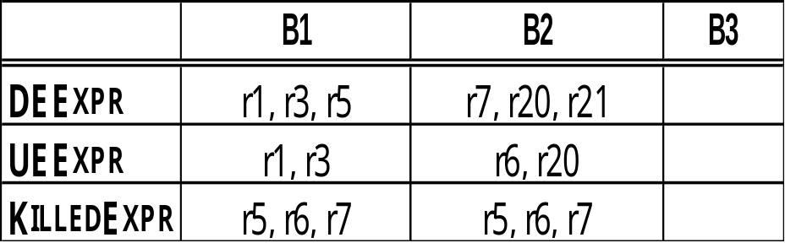
Lazy Code Motion: Running Example
B₁: r₁ ← 1
r₂ ← r₁
r₃ ← r₀ + @m
r₄ ← r₃
r₅ ← (r₁< r₂)
if r₅ then B₂ else B₃
B₂: r₂₀ ← r₁₇ * r₁₈
r₂₁ ← r₁₉ + r₂₀
r₈ ← r₂₁
r₆ ← r₂ + 1
r₂ ← r₆
r₇ ← (r₂> r₄)
if r₇ then B₃ else B₂
B₃: ...
Variables: r₂, r₄, r₈
Expressions: r₁, r₃, r₅, r₆, r₇, r₂₀, r₂₁

Slide 17
Lazy Code Motion
Availability
Initialize AVAILIN(n) to the set of all names, except at n₀
Set AVAILIN(n₀) to Ø
Interpreting AVAIL
e ∈ AVAILOUT(b) ⇔ evaluating e at end of b produces the same value for e. AVAILOUT tells the compiler how far forward e can move the evaluation of e, ignoring any uses of e
This differs from the way we talk about AVAIL in global redundancy elimination
AVAILIN(n) = ∩_{m∈ preds(n)} AVAILOUT(m), n ≠ n₀
AVAILOUT(m) = DEEXPR(m) ∪ (AVAILIN(m) ∩ KILLEDEXPR(m))

Slide 18
Lazy Code Motion
Anticipability
ANTOUT(n) = ∩_{m∈ succs(n)} ANTIN(m), n not an exit block
ANTIN(m) = UEEXPR(m) ∪ (ANTOUT(m) ∩ KILLEDEXPR(m))
Initialize ANTOUT(n) to the set of all names, except at exit blocks
Set ANTOUT(n) to Ø, for each exit block n
Interpreting ANTOUT
e ∈ ANTIN(b) ⇔ evaluating e at start of b produces the same value for e. ANTIN tells the compiler how far backward e can move
This view shows that anticipability is, in some sense, the inverse of availability (& explains the new interpretation of AVAIL).

Slide 19
Lazy Code Motion
Earliest placement
EARLIEST(i,j) = ANTIN(j) ∩ AVAILOUT(i) ∩ (KILLEDEXPR(i) ∪ ANTOUT(i))
EARLIEST(n₀,j) = ANTIN(j) ∩ AVAILOUT(n₀)
EARLIEST is a predicate
Computed for edges rather than nodes (placement )
e ∈ EARLIEST(i,j) if
  It can move to head of j,
  It is not available at the end of i, and
    either it cannot move to the head of i (KILLEDEXPR(i))
    or another edge leaving i prevents its placement in i (ANTOUT(i))

Slide 20
Lazy Code Motion
Later (than earliest) placement
LATERIN(j) = ∩ _{i ∈ preds(j)} LATER(i,j), j ≠ n₀
LATER(i,j) = EARLIEST(i,j) ∪ (LATERIN(i) ∩ UEEXPR(i))
Initialize LATERIN(n₀) to Ø
x ∈ LATERIN(k) ⇔ every path that reaches k has x ∈ EARLIEST(m) for some block m, and the path from m to k is x-clear & does not evaluate x
⇒ the compiler can move x through k without losing any benefit
x ∈ LATER(i,j) ⇔ <i,j> is its earliest placement, or it can be moved forward from i (LATER(i)) and placement at entry to i does not anticipate a use in i (moving it across the edge exposes that use)

Slide 21
Lazy Code Motion
Rewriting the code
INSERT & DELETE are predicates
Compiler uses them to guide the rewrite step
x ∈ INSERT(i,j) ⇒ insert x at start of i, end of j, or new block
x ∈ DELETE(k) ⇒ delete first evaluation of x in k
INSERT(i,j) = LATER(i,j) ∩ LATERIN(j)
DELETE(k) = UEEXPR(k) ∩ LATERIN(k), k ≠ n₀
If local redundancy elimination has already been performed, only one copy of x exists. Otherwise, remove all upward exposed copies of x.
*

Slide 22
Lazy Code Motion
Edge placement
x ∈ INSERT(i,j)
Three cases
|succs(i)| = 1 ⇒ insert at end of i
|succs(i)| > 1 but |preds(j)| = 1 ⇒ insert at start of j
|succs(i)| > 1 and |preds(j)| > 1 ⇒ create new block in <i,j> for x
B_{i}
B_{i}
B_{h}
B_{i}
x
x
B_{j}
x
B_{j}
B_{k}
B_{j}
B_{k}
|succs(i)| = 1
|preds(j)| = 1
|succs(i) > 1
|preds(j)| > 1

Slide 23
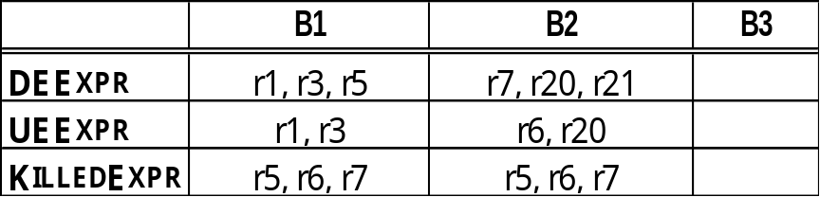
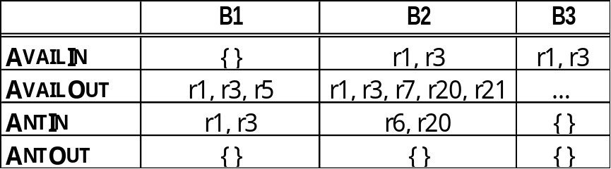
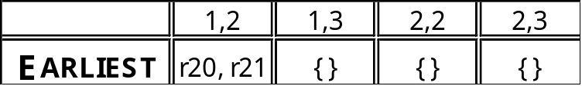
Lazy Code Motion Example
B₁: r₁ ← 1
r₂ ← r₁
r₃ ← r₀ + @m
r₄ ← r₃
r₅ ← (r₁< r₂)
if r₅ then B₂ else B₃
B₂: r₂₀ ← r₁₇ * r₁₈
r₂₁ ← r₁₉ + r₂₀
r₈ ← r₂₁
r₆ ← r₂ + 1
r₂ ← r₆
r₇ ← (r₂> r₄)
if r₇ then B₃ else B₂
B₃: ...
B₁
B₂
B₃
Example is too small to show off LATER
INSERT(1,2) = { r₂₀, r₂₁ }
DELETE(2) = { r₂₀ , r₂₁ }

